Slide 1

Movie Ticket Booking Management System
A Database Management System Project
Akshaya B | CSE (AI & ML) | MySQL & MySQL Workbench

Slide 2

Introduction & Problem Statement
What This System Manages
Problem Statement
Traditional booking systems struggle to manage movie information, available seats, customer bookings, and payment records efficiently. This project organizes all information in a structured relational database and reduces data redundancy.
Movies
Users
Screens
Seats
Shows
Bookings
Payments

Slide 3
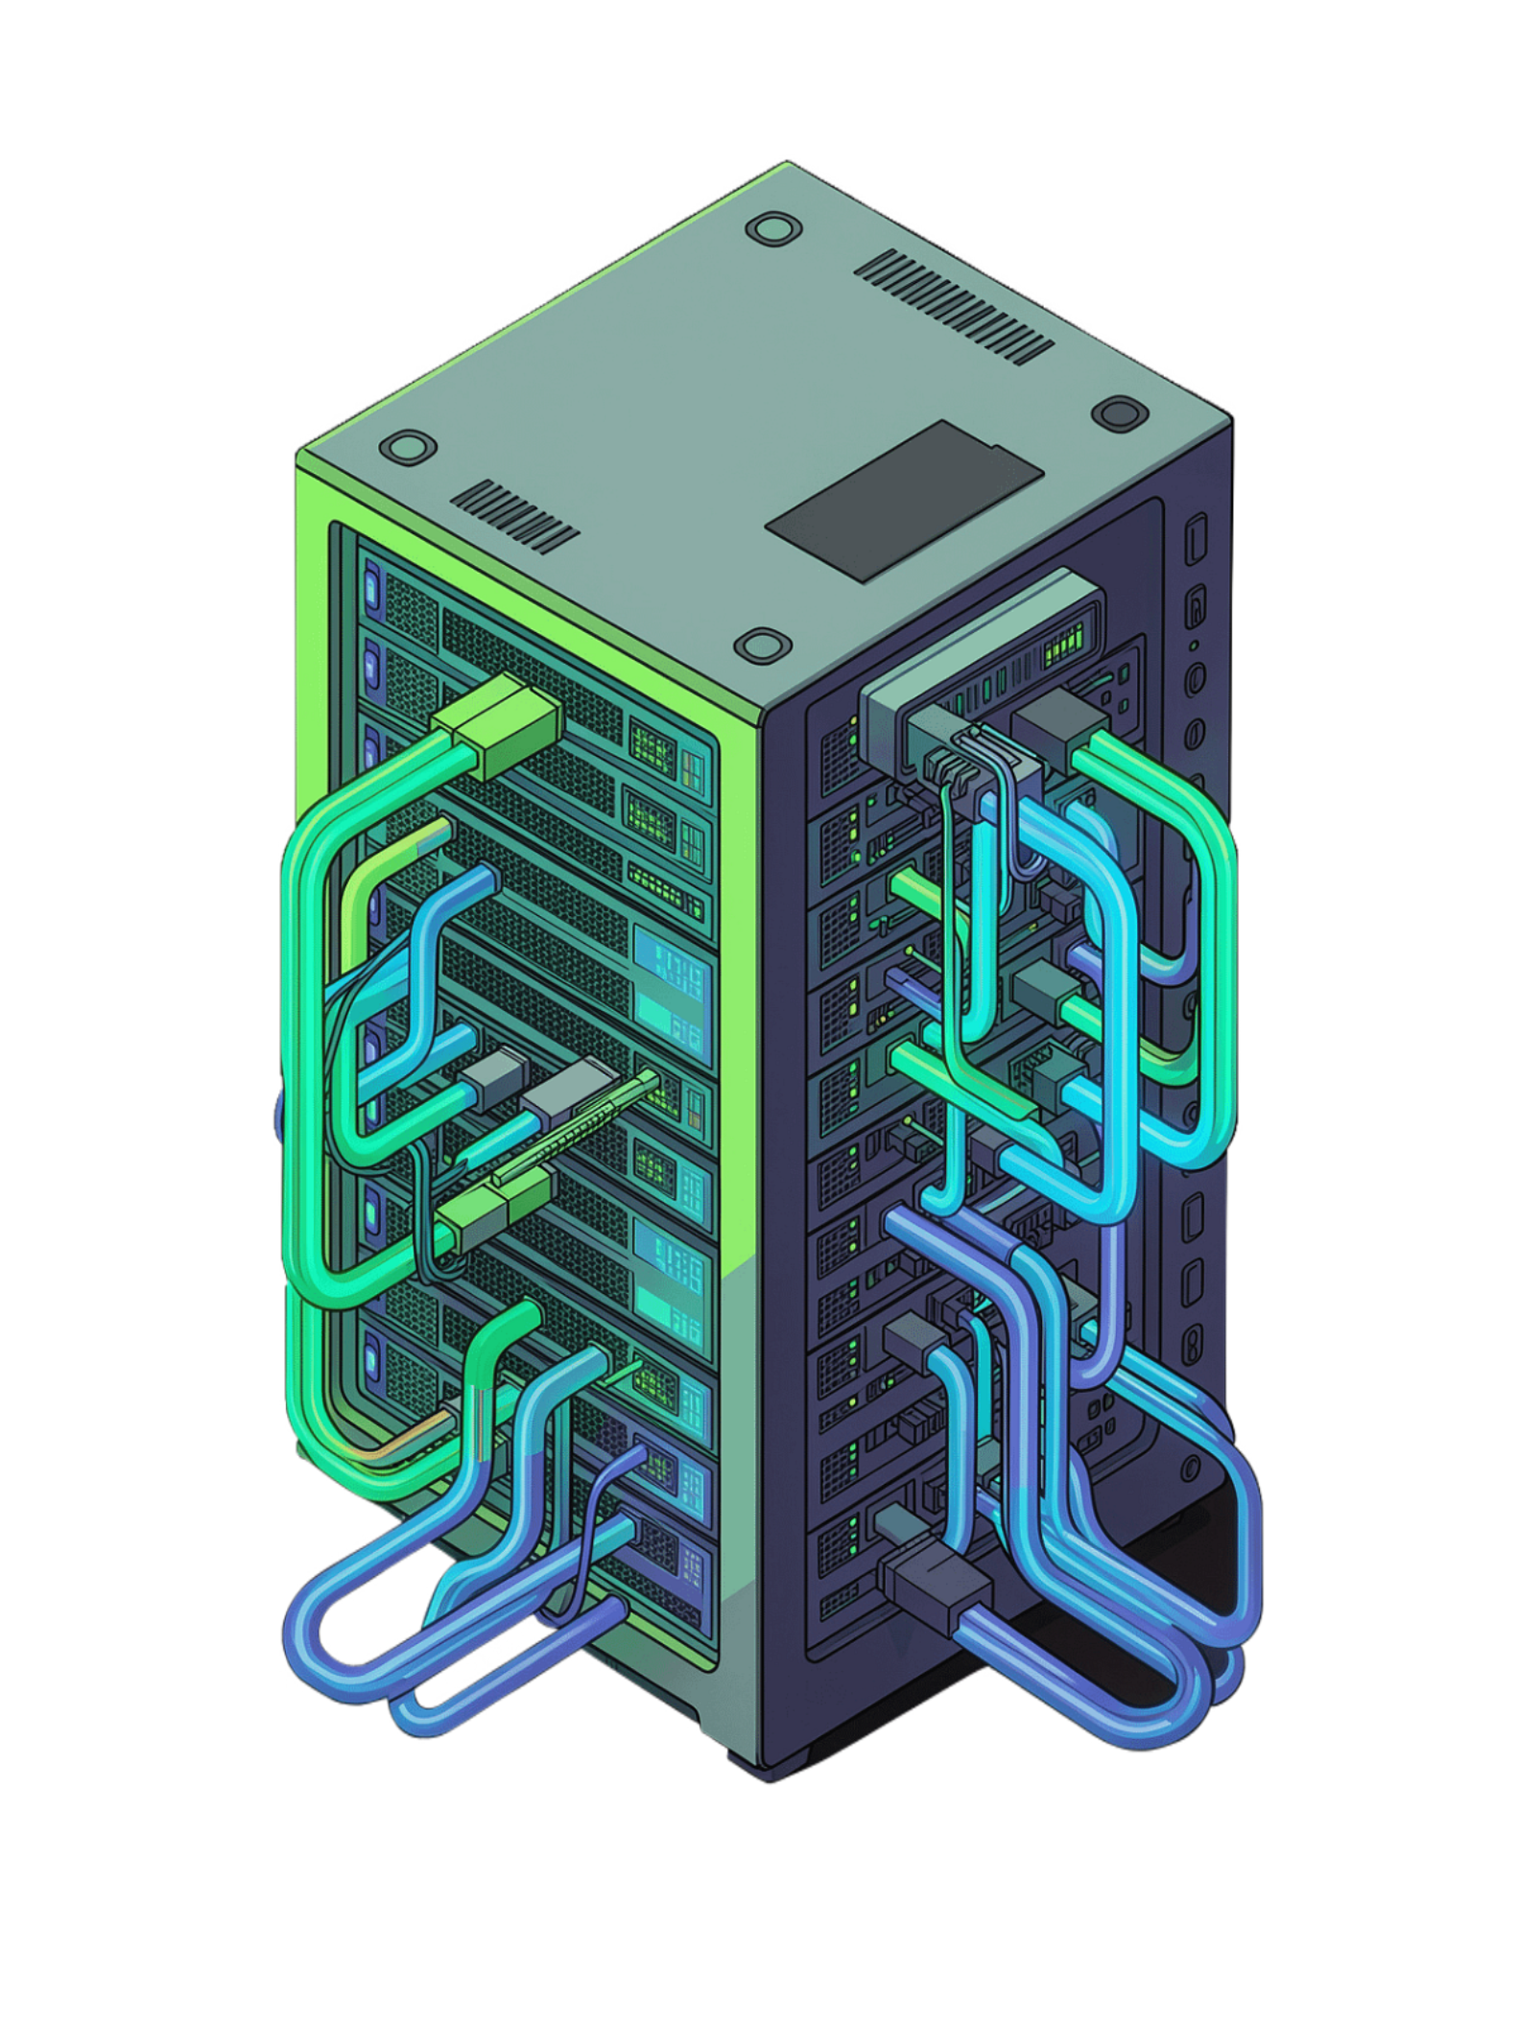




Objectives & Technologies Used
Objectives
Technologies Used
Create a centralized movie booking database
MySQL Server
Core database engine
Manage movies, cinema screens, seats & shows
MySQL Workbench
Store user information and record bookings & payments
GUI design & management tool
Demonstrate important DBMS concepts
SQL
Structured Query Language
RDBMS
Relational Database Model

Slide 4








Database Structure
MOVIE_BOOKING_DB
The database contains 8 main tables connected through primary and foreign keys to maintain data integrity.
users
movies
Customer information
Movie details
screens
seats
Cinema screens
Seat information
shows
bookings
Movie shows
Customer bookings
booking_seats
payments
Seats per booking
Payment records

Slide 5
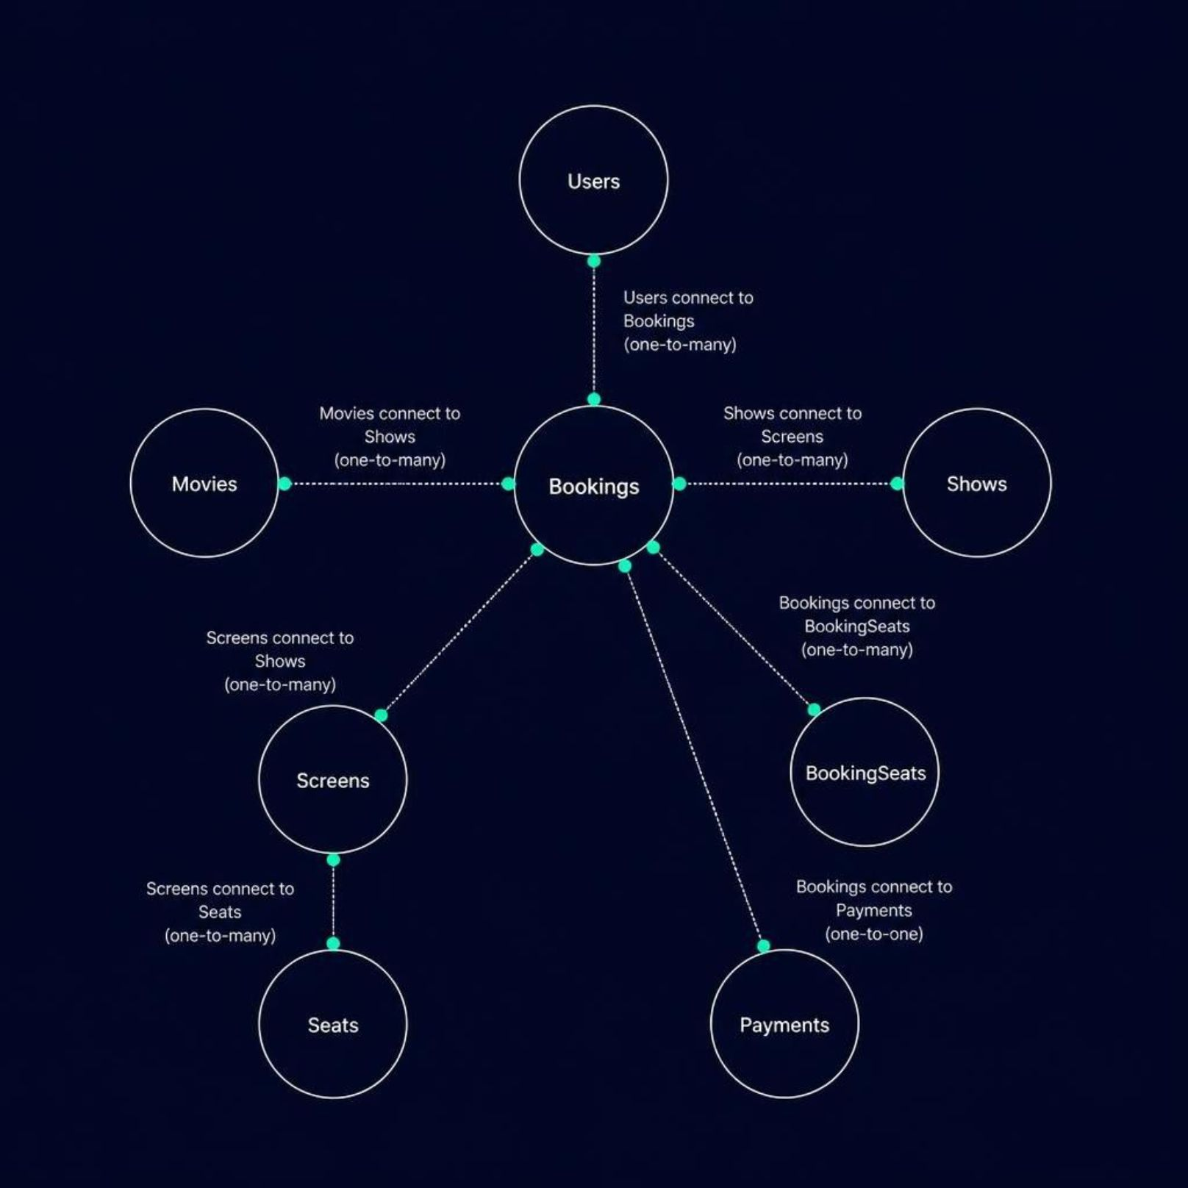




Database Relationships
ER Diagram Overview
Key relationships in the system:
One user can have multiple bookings
One movie can have multiple shows
One screen contains multiple seats
One screen can host multiple shows
One booking can contain multiple seats
Each booking contains payment information

Slide 6
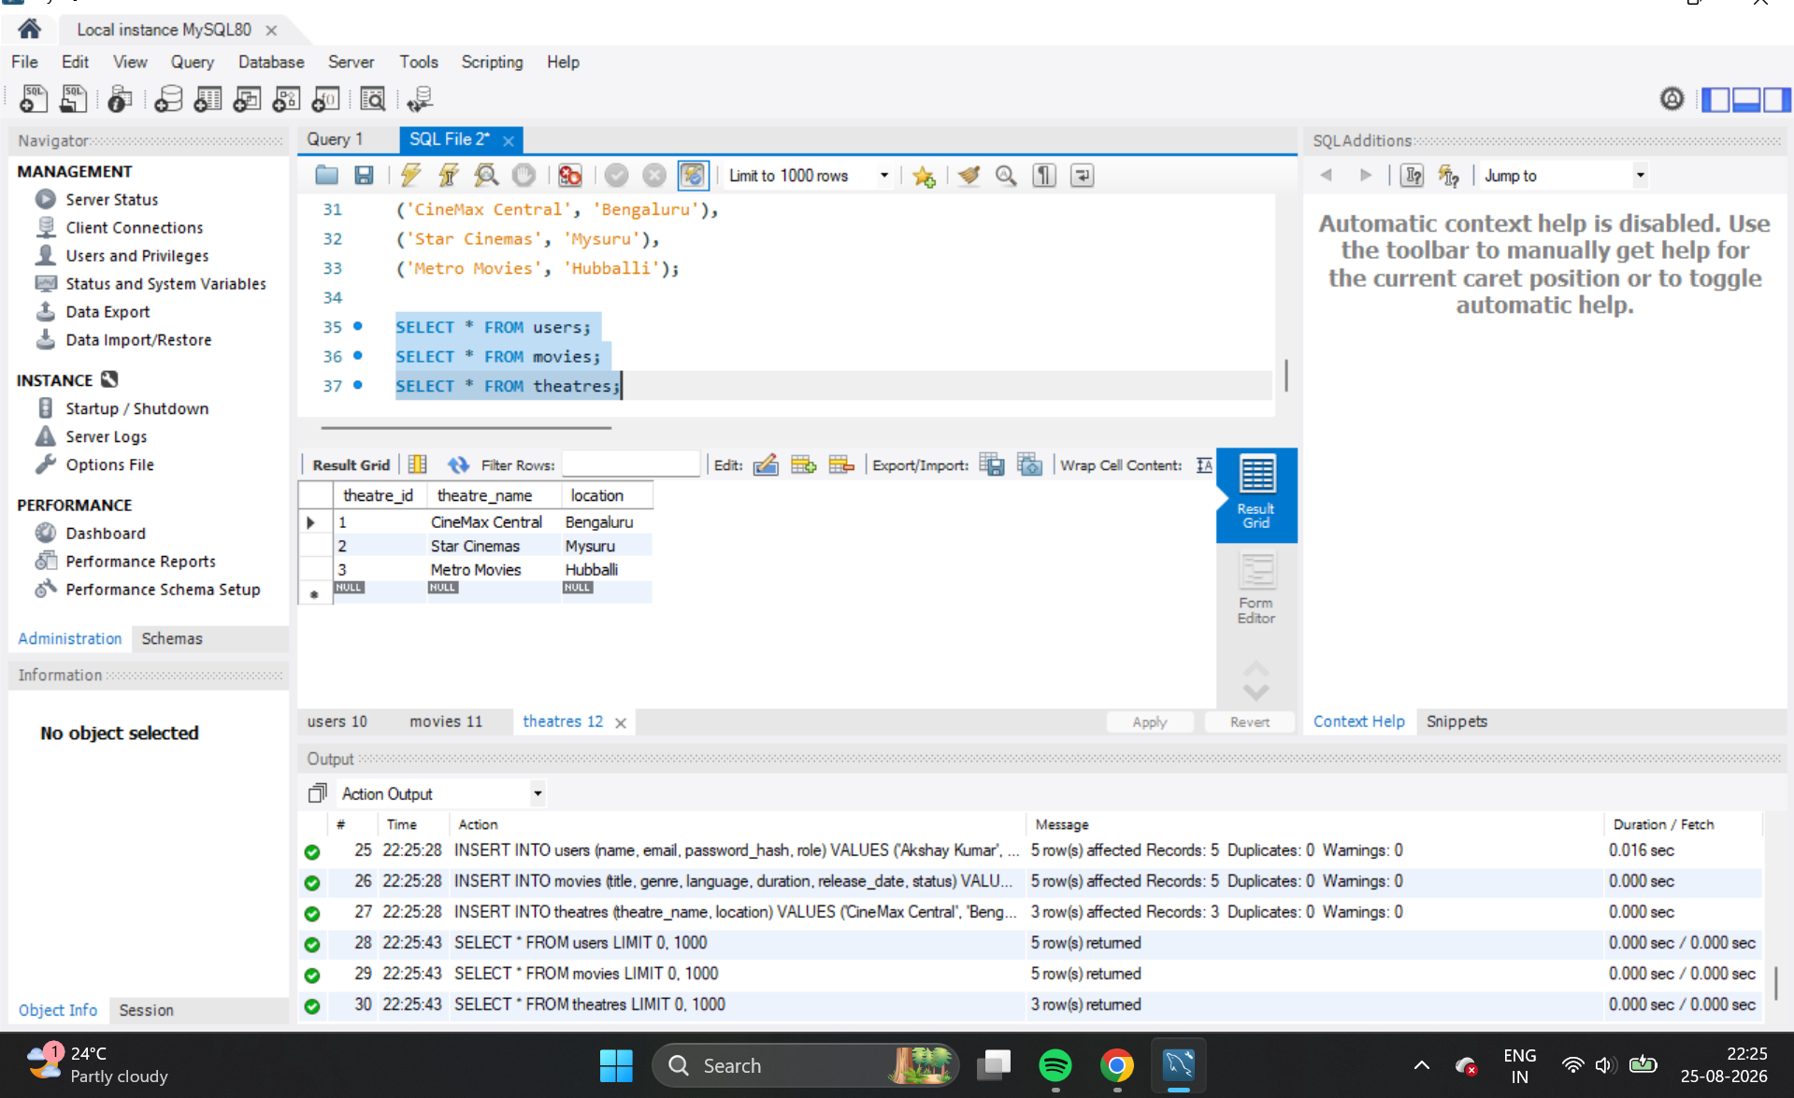





SQL Operations & Queries
Basic SQL Operations (CRUD)
Advanced Queries
INSERT
SELECT
JOIN Operations
Aggregate Functions
Add movies, users, bookings & payments
Retrieve data from tables
Connect multiple tables to retrieve related data across users, bookings, movies & payments
COUNT, SUM, AVG for data analysis and reporting on bookings and revenue
UPDATE
DELETE
Modify existing information
Remove records
[Placeholder: MySQL Workbench Query Screenshot]
MySQL Workbench output: INSERT and SELECT operations

Slide 7
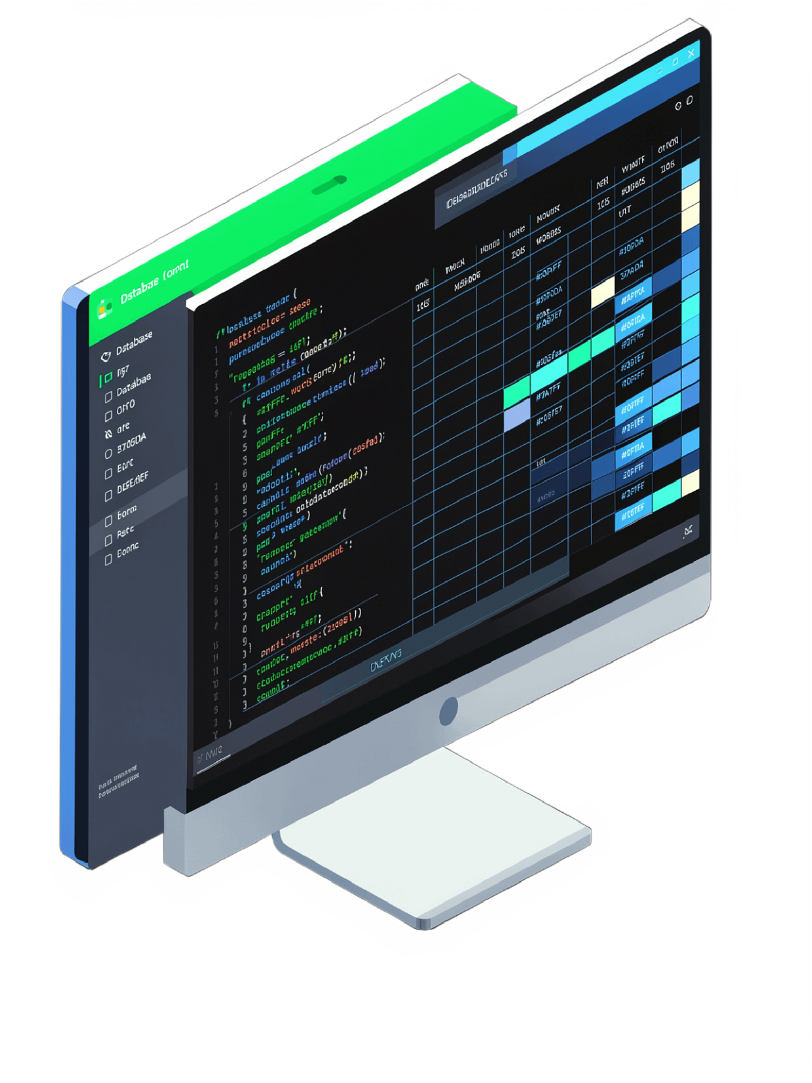

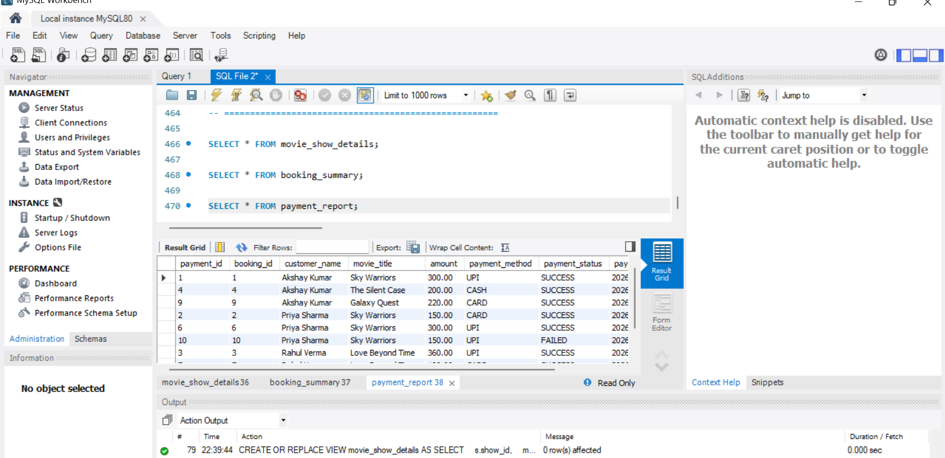



Database Views & Stored Procedure
Views Created
Stored Procedure
Views and stored procedures simplify and organize SQL operations, making data retrieval faster and more maintainable.
movie_show_details
1
Displays movie and show information combined
[Placeholder: MySQL Workbench Screenshots]
booking_summary
2
Displays summarized booking details per user
payment_report
3
Displays payment info with customer and movie details
Views executed successfully: movie_show_details, booking_summary, payment_report
GetUserBookings()
Retrieves complete booking details for a specific user by user ID

Slide 8

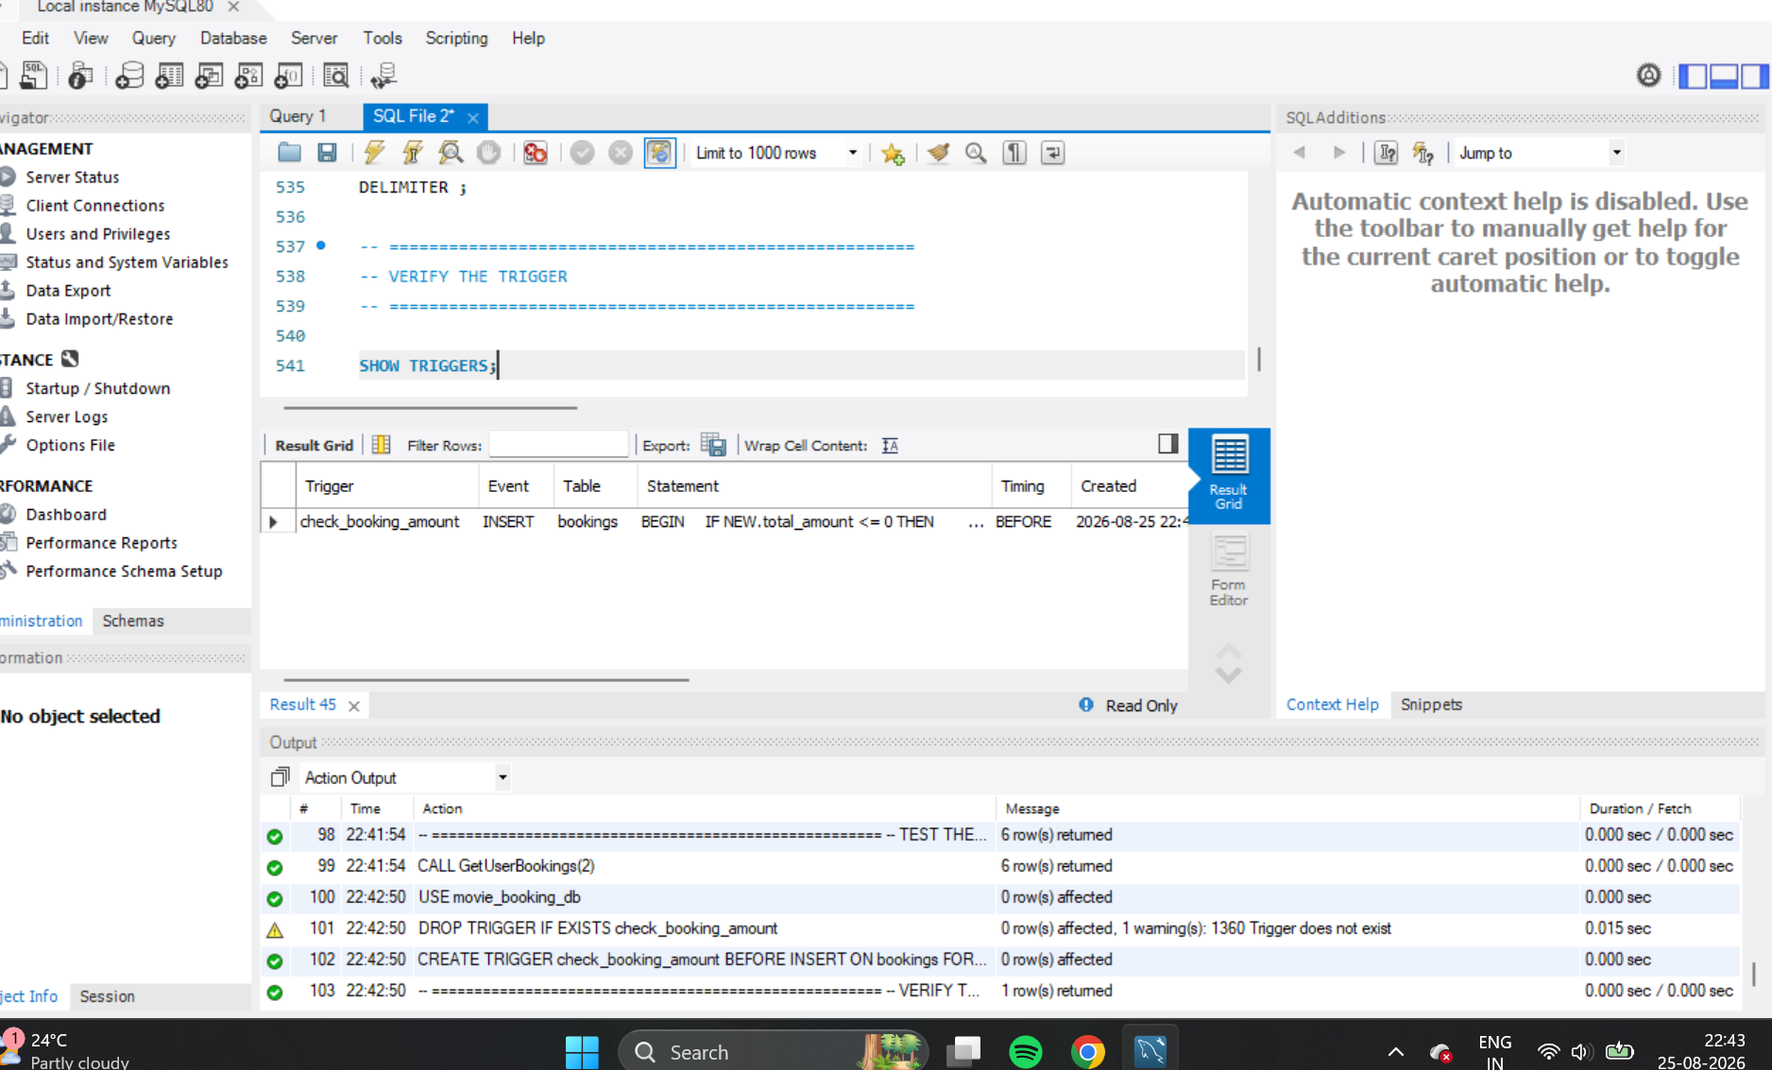
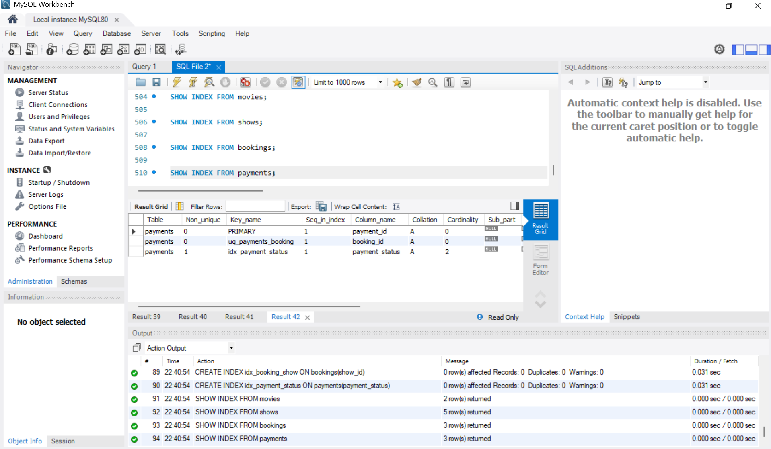
Trigger & Indexes
Trigger: check_booking_amount
Indexes
Indexes were created on important columns such as user ID, movie ID, and show ID to improve query performance and retrieve records faster — especially critical with large datasets.
[Placeholder: Screenshots]
Trigger verification: check_booking_amount
Timing
Table
Purpose
BEFORE INSERT — fires before a new record is added
bookings — the core transaction table
Validates booking amount before inserting a new booking record to prevent invalid data
Indexes created and verified in MySQL Workbench

Slide 9

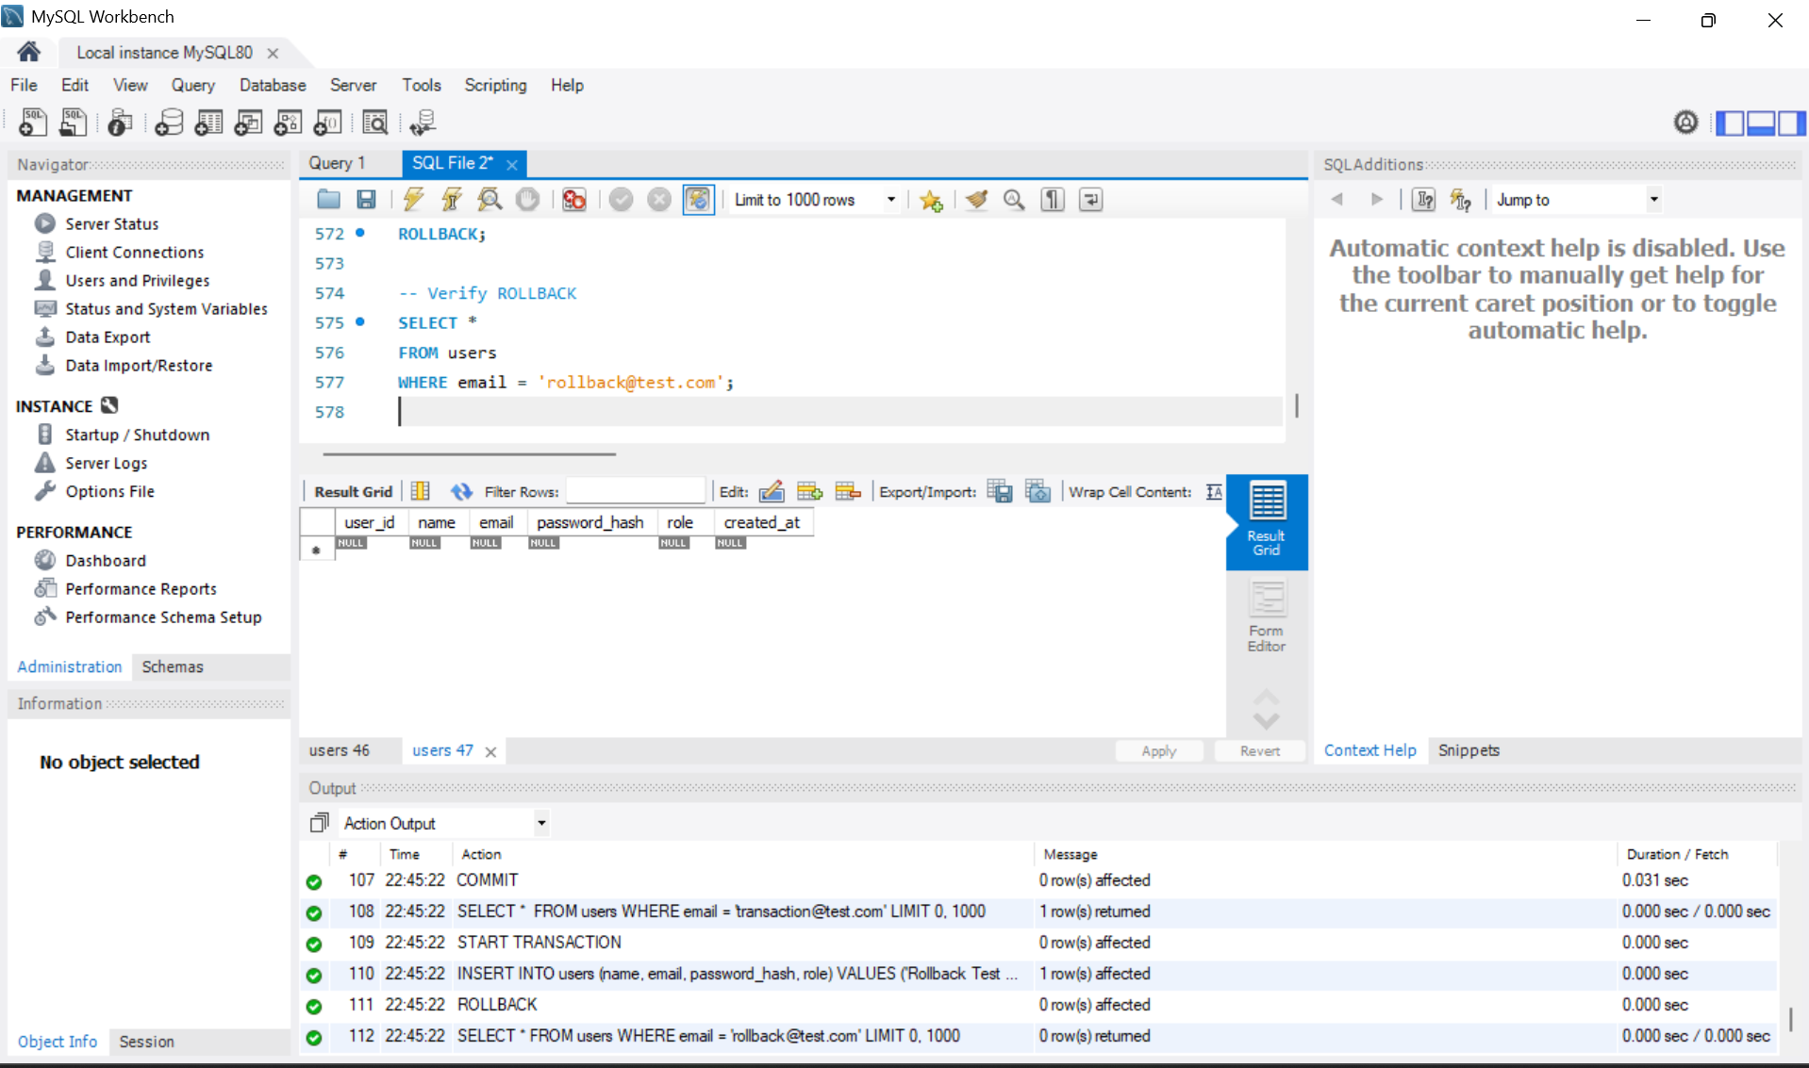
Transactions: COMMIT & ROLLBACK
The project demonstrates database transactions for data consistency and integrity.
Commit or Rollback
Save or undo changes
Database Operations
INSERT, UPDATE, DELETE
Start Transaction
Begin atomic operations
Transaction test showing COMMIT and ROLLBACK
COMMIT
ROLLBACK
Permanently saves all changes made during a transaction. Once committed, data is written to the database and cannot be undone.
Cancels and undoes all changes made during a transaction. Restores the database to its previous stable state.

Slide 10
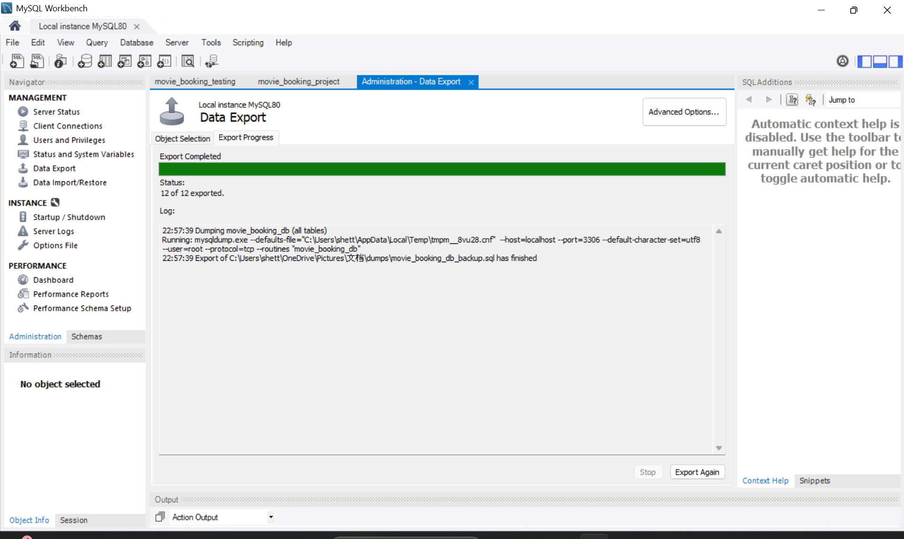

Database Backup & Project Results
Database Backup
Successfully Implemented ✓
A complete backup of movie_booking_db was created using MySQL Workbench, containing the full database structure, all tables, inserted data, and all database objects (views, procedures, triggers).
✓ Tables & Primary Keys
✓ Foreign Keys & Relationships
✓ Data Insertion & Management
✓ SQL Queries & JOINs
✓ Views & Stored Procedure
✓ Trigger for Validation
✓ Indexes for Performance
✓ Transactions & Backup
Database backup completed successfully: 12 of 12 objects exported

Slide 11





Conclusion
The Movie Ticket Booking Management System successfully demonstrates important DBMS concepts using MySQL — providing a structured way to manage movies, screens, seats, shows, users, bookings, and payments.
Relationships & Integrity
SQL Queries & Views
Triggers & Indexes
Transactions & Backup
Thank You 🎬 Questions?

